Slide 1
Putting the right information on 3905 Century Club QSL cards
A presentation by Marty Blaise, AG5T
A visual power point based on information originally provided by KB3PU on the club web site at
http://www.3905ccn.com/qslcardinfohtm

Slide 2
Much of the material on this power point will be taken from this section of the club web site. We will start our discussion from this page as seen below.

Slide 3
A properly completed QSL card is essential to the 3905 Century Club awards program
QSL cards contain two types of information about a QSO:
Information about the sender’s side of the QSO and
Information about the recipient’s side of the QSO.
It’s very important that the QSL cards be designed and filled out in a manner that makes it clear which side of the QSO each item on the card describes.
Placement of this information is important so there is no doubt that an entry saying , “w/ club AA1AAA” refers to the recipient’s club and not the sender’s club. Or you can make it clear by saying “w/ YOUR club AA1AAA” or “w/ MY club AA1AAA. What you can’t do is scatter information all over your card so it isn’t clear who it refers to because such cards will not usable toward 3905 CC awards and you will be asked to replace them with usable cards.
Now will we look at the information required on a QSL card if it is to be useful towards all the awards the club offers

Slide 4
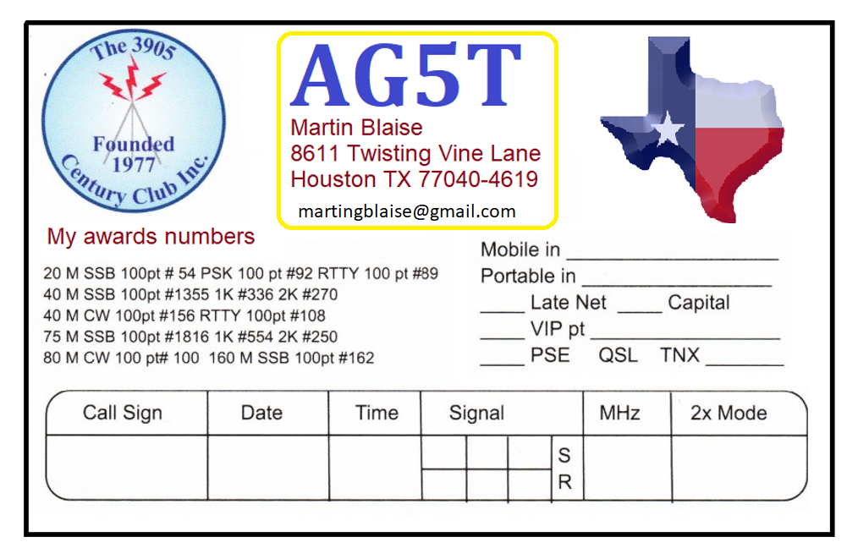
QSL CARD REQUIREMENTS
Your call sign
Your location, particularly state (province, country). Include the city if it’s the capital of the state, province or country.
Tip: if you want to include your email address, you could list it under your mailing address.
Note: this is my layout. There are many ways you can lay out your card design.
Tip: a suggested size for QSL cards is 5 ½ inches wide by 3 ½ inches tall.

Slide 5
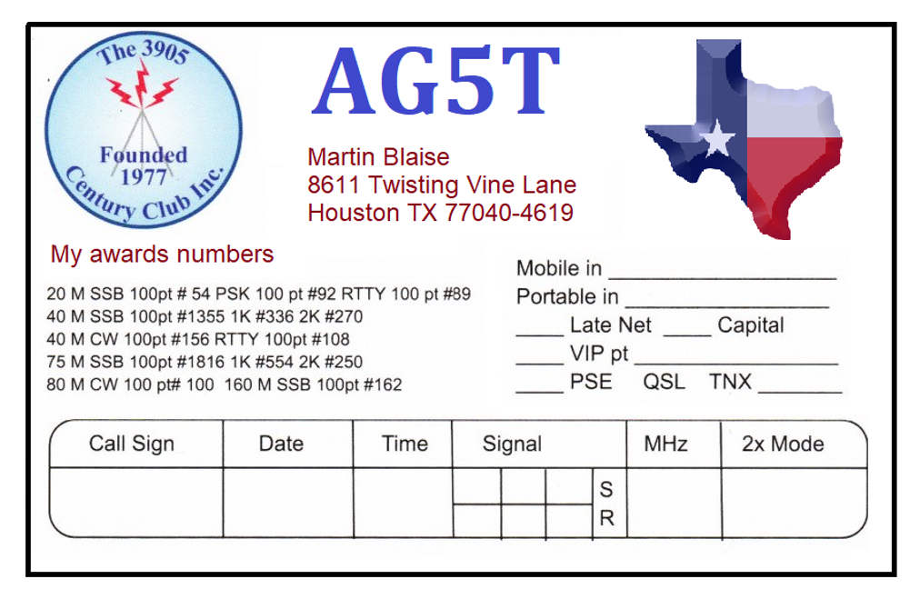
#3 Indicate if you were mobile or portable and where In addition to state(s), province(s), country, “where” includes which National Park, high point, low point and any other location that may be important to your or someone else’s awards purposes.
Arkansas

Slide 6
UTC date of the contact and #5 the UTC time of the contact
From the web site: please use DD-MM-YYYY format (04-Mar-2021) to avoid confusion between US and DX date formats – DD-MM-YY vs MM-DD-YY. Take a date like 01-02-03 for example. Is that 02-Jan-2003, 01-Feb-2003, or something else that places the year first like 2001-Mar-02 or 2001-Feb-03? Or you can write out the month along with a 4-digit year and there’s no doubt.
07/02/2021
03:11

Slide 7
QSL CARD REQUIREMENTS
the frequency on which the contact was made. The band is acceptable, but the frequency is usually preferred.
3.902

Slide 8
Special for QSLs to DX stations operating split must show the band, not the FREQUENCY. Stations operate split because they aren’t allowed to operate on our net frequency, so a card showing only our net frequency essentially confirms an illegal contact, preventing the DX station from using that card.
For forty meters, I put 7 for the MHz if it’s a split contact.
7

Slide 9
A QSL card needs the mode of the contact such as SSB, RTTY, PSK31 or CW. Be careful when writing your signal reports that you put 599 on RTTY and not 5x9 etc.
Indicating something like 75 meter early SSB net is not required, but it is helpful to Area Awards Managers.
75 meter early net
9 9
RTTY
5 9 9

Slide 10
The call sign of the station you worked.
The signal report sent to the station you worked. Both the signal report you sent and received is preferred and it’s necessary if the contact was made with a station that wasn’t logging.
Important! If the other station was mobile or portable indicate their mobile/portable status and where they were. They need this information on their card for their awards purposes.
K4JEL/M
North Carolina
X 9
5 X 9

Slide 11
Show on your QSL card any 3905CC progressive awards you hold and their certificate numbers. Also any with certificates 2, 22 and ending in 02 are wild deuces. Master’s degree number should be listed. Some may choose to show additional awards earned but this isn’t required (a 2-sided card would be better if you want to list many awards).

Slide 12
If you are club officer or a VIP, be sure to include that on your card as well. NCS is a VIP when running a net and is worth 1 point.
The QRP status is not absolutely required, but some stations do request this information, so if a station requests it, list it as QRP 5 watts on the card as an example.
The county you were in is helpful to those who might collect County Hunter awards BUT the 3905CC is NOT a county hunters net. You can list the county in your address if you wish.
1 Net Control

Slide 13
Club Call specific information:
There are a number of club stations on our nets and some of them want a card for their contact with you in addition to the operator of the club call sign.
Club calls are either:
No card needed (NCN)
Card requested club
If you work a card requested club, you need to include the operator somewhere on the card such as OP: KL7JR.
KL7RST
(OP:KL7JR)

Slide 14
Additional information
As much as possible the QSL information should be on one side of the card so those who submit photocopied cards don’t have to photocopy both sides.
Anything else you want to put on the card such as pictures and equipment is okay as long as it doesn’t interfere with reading the necessary information. These are the things that make the card an expression of yourself. In my case I have the club logo and a state map. These are not required but many like to include them and many enjoy seeing them.
Tip: I have one sided cards. To help the bureau managers when I send a card requested club card, I flip to the blank side and write the call sign of the operator. Then the managers can sort the card faster.

Slide 15
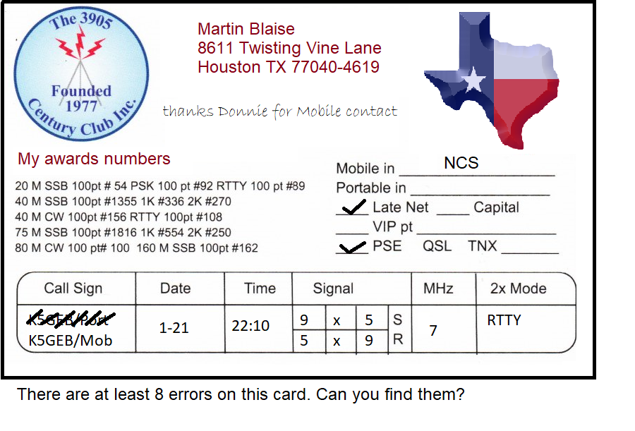

Slide 16
Questions and Comments?

